Slide 1

Concrete crack detection system – phase 1

Slide 2
Data EXPLORATION
My data is unstructured data. It is divided into two classes - 20000 negative images representing normal concretes and 20000 positive images representing crack concretes
There's a total of 40000images of 227x227 pixels with RGB channels.
These images are best represented in a data frame with two columns, one for the File path and the other for the label as seen in the next slide

Slide 3
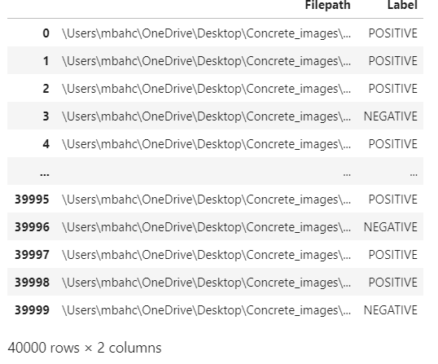
Data exploration
As seen in the figure, my data frame has two columns, 'Filepath' and 'Label'.
It has a total of 40000 observations or rows representing 40000 images.
Dataframe

Slide 4
Data splitting, preprocessing and creating generators
Using train_test_split from Sklearn.model_selection library , my data is split into train and test data in the ratio 80:20
This ratio gives us a total of 32000 images reserve for training and 8000 images for testing.
Normalization is the most crucial step in image pre-processing. This refers to rescaling the pixel values so that they lie within a confined range. Our original images consist in RGB coefficients in the 0-255 , but such values would be too high for this model to process , so we target values between 0 and 1 instead by scaling with a 1/255.

Slide 5
Data splitting, preprocessing and creating generators
Create three generators train_gen, validation_gen and test_gen each with validated images belonging to two classes
In the prepocessing phase, validation_split is allocated as 0.1 of train dataset
These classes are either positive or negative. The three generators are:
Train_gen: 28800 validated image filenames in two classes
Validation_gen: 3200 validated image fienames in two classes
Test_gen: 8000 validated image filenames in two classes

Slide 6
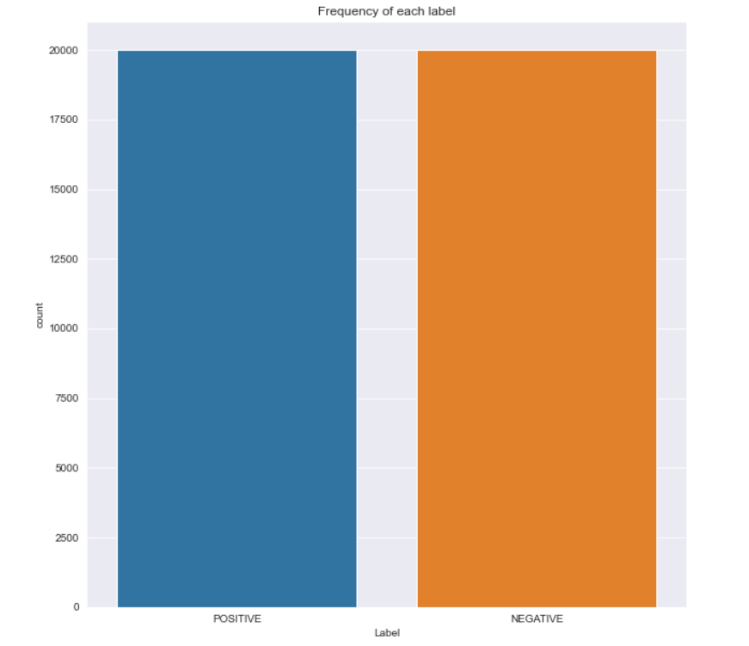
Data visualization
This involves understanding my datasets by placing it in a visual context so that patterns, trends and correlations that might not otherwise be detected can be exposed.
Histogram
They are two classes of labels- positive and negative
20000 images have a positive label and the other 20000 have a negative label

Slide 7
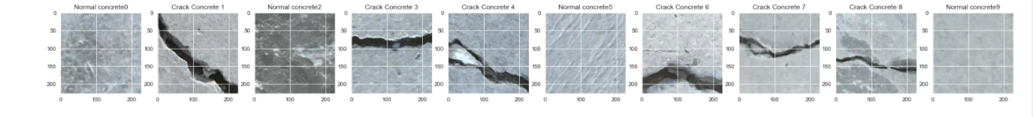
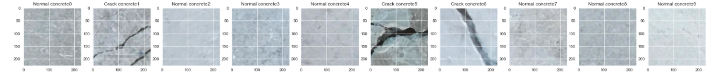
Preview of images in train and test dataset
Images in train dataset
Images in test dataset

Slide 8
Data augmentation
Image Augmentation is a way of applying different types of transformation techniques on actual images, thus producing copies of the same image with alterations. This helps to train deep learning models on more image variations than what is present in the actual dataset . See some of the techniques on the next slide

Slide 9
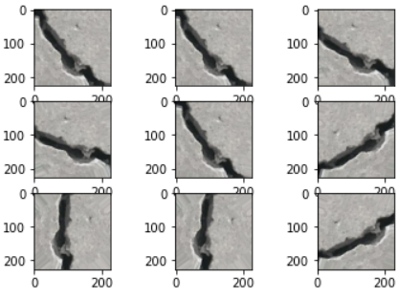
Data augmentation Techniques
Radom rotation
The image rotation technique enables the model by generating images of different orientations. The ImageDataGenerator class in Keras uses this technique to generate randomly rotated images in which the angle can range from 0 degrees to 360 degrees.

Slide 10
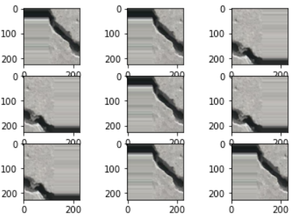
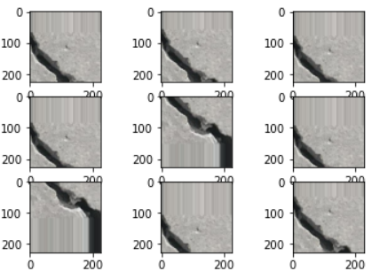
Data augmentation Techniques
Random shift
The random shifts technique helps in improving those images that are not properly positioned . Keras ImageDataGenerator uses parameters height_shift_range for vertical shifts in an image and for horizontal shifts in an image, we can use width_shift_range
Horizontal shift
Vertical shift

Slide 11
DATA AUGMENTATION TECHNIQUES
Other techniques includes:
Radom flips
Random zoom
Random brightness

Slide 12
Building the Convolutional neural network (cnn ) model
Creating the convolutional base:
The model has different layers;
Input layer: This is a layer in which the input image is fed into the CNN model. The input is of shape (image_height, image_width, color_channels). For this project my input shape is (120, 120, 3)
Three convolutional layer each followed by a MaxPooling layer
The activation is a mathematical gate in between the input feeding the current neuron and its output going to the next layer. They basically decide whether the neuron should be activated or not.
ReLU activation function is widely used and is default choice as it yields better result

Slide 13
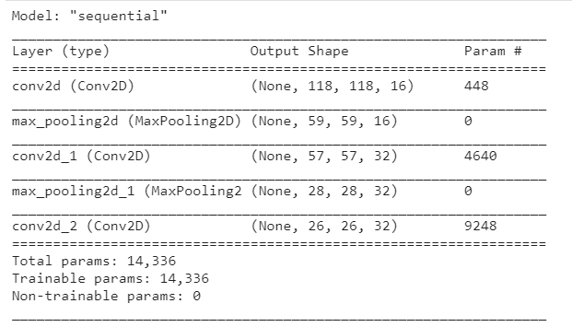
BUILDING THE CNN MODEL
The convolutional base summary as seen below
As seen in the figure, the output of every Conv2D and MaxPooling2D layer is a 3D tensor of shape (height, width, channels). The width and height dimensions tend to shrink as you go deeper in the network. Typically, as the width and height shrink, you can afford (computationally) to add more output channels in each Conv2D layer.

Slide 14
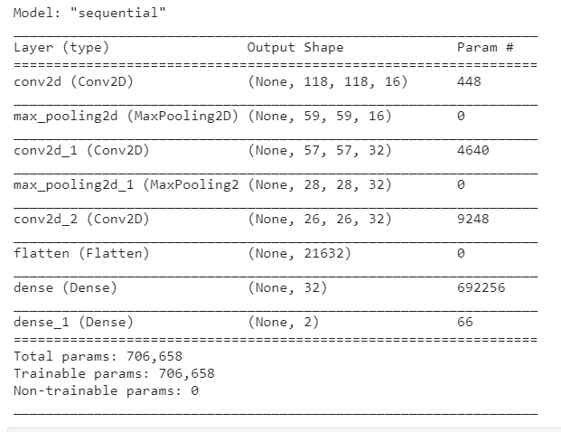
Building the cnn model
Adding dense layers on top
To complete the model, feed the last output tensor from the convolutional base (of shape (26, 26, 32)) into one or more Dense layers to perform classification. Dense layers take vectors as input (which are 1D), while the current output is a 3D tensor. First, flatten (or unroll) the 3D output to 1D, then add one or more Dense layers on top. My image dataset has 2 output classes, so I will use a final Dense layer with 2 outputs.
Model summary

Slide 15
References
[1] Özgenel, Ç. F. (2019, 07 23). Mendeley Data. Retrieved from Concrete Crack Images for Classification: https://data.mendeley.com/datasets/5y9wdsg2zt/2
[2] SCIENTIFIC, G. (2019, August 17). Evaluating Cracking in Concrete: Procedures. Retrieved from GIATEC: https://www.giatecscientific.com/education/cracking-in-concrete-procedures/
[3] Vadapalli, P. (2021, February 25). Image Classification in CNN: Everything You Need to Know. Retrieved from upgradeblog: https://www.upgrad.com/blog/image-classification-in-cnn/
[4] Wikipedia. (2021, February 13). 2013 Dhaka garment factory collapse. Retrieved from Wikipedia: https://en.wikipedia.org/wiki/2013_Dhaka_garment_factory_collapse

Slide 16
END OF PHASE 1

